Slide 1
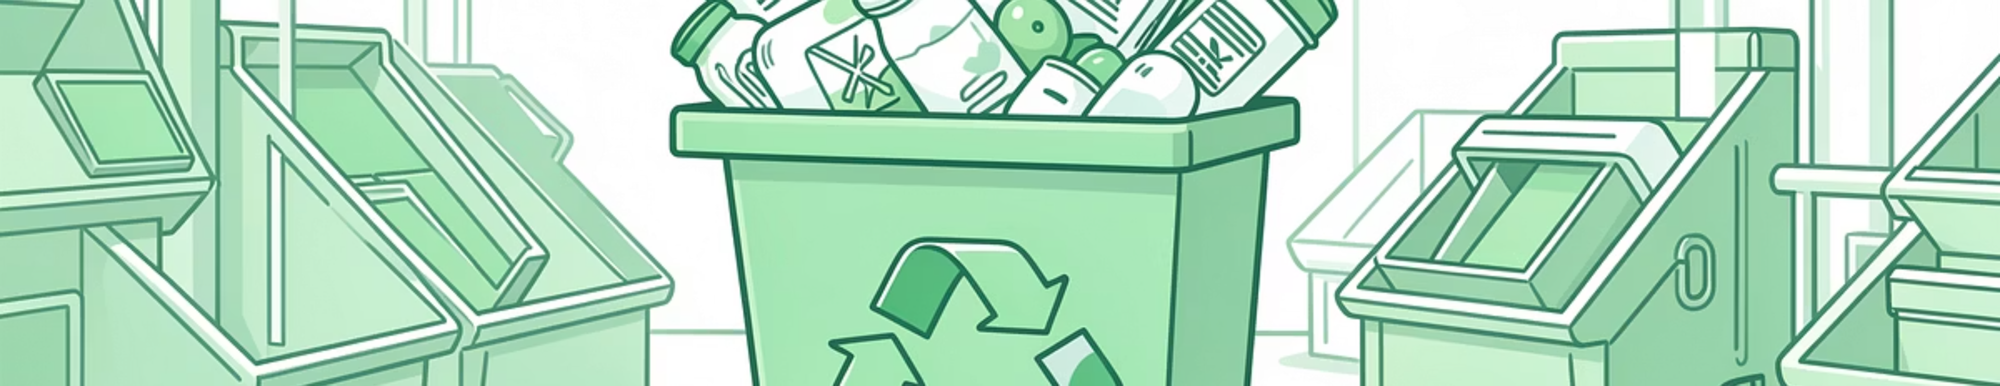




GREEN SKILLS PEER TRAINING EXCHANGE
RECYCLING
March 2026, Eskisehir, Türkiye
The European Commission's support for the production of this publication does not constitute an endorsement of the contents, which reflect the views only of the authors, and the Commission cannot be held responsible for any use which may be made of the information contained therein.

Slide 2
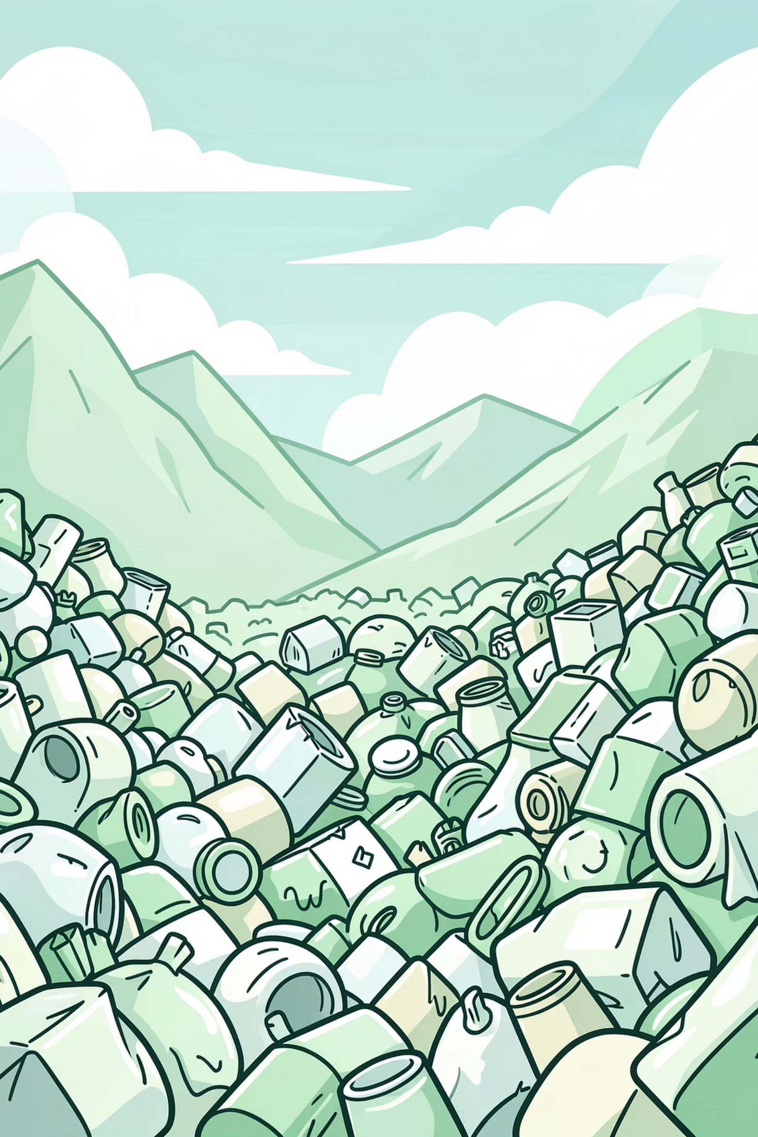
What Happens to Your Trash?
Every year, the world produces over 2 billion tons of waste — and most of it doesn't just disappear. Where does yours go?

Slide 3
The Scale of the Problem
Your Trash Has a Hidden Life
2B+
50%+
80x
1–2kg
Tons of Waste
Goes to Landfills
More Potent
Per Person / Day
Generated globally every single year
In many countries worldwide
Methane vs. CO₂ in the short term
Average waste generated by one person daily
Landfills aren't just ugly — they actively release methane, a greenhouse gas far more damaging than CO₂. The problem is massive, but so is our power to change it.

Slide 4
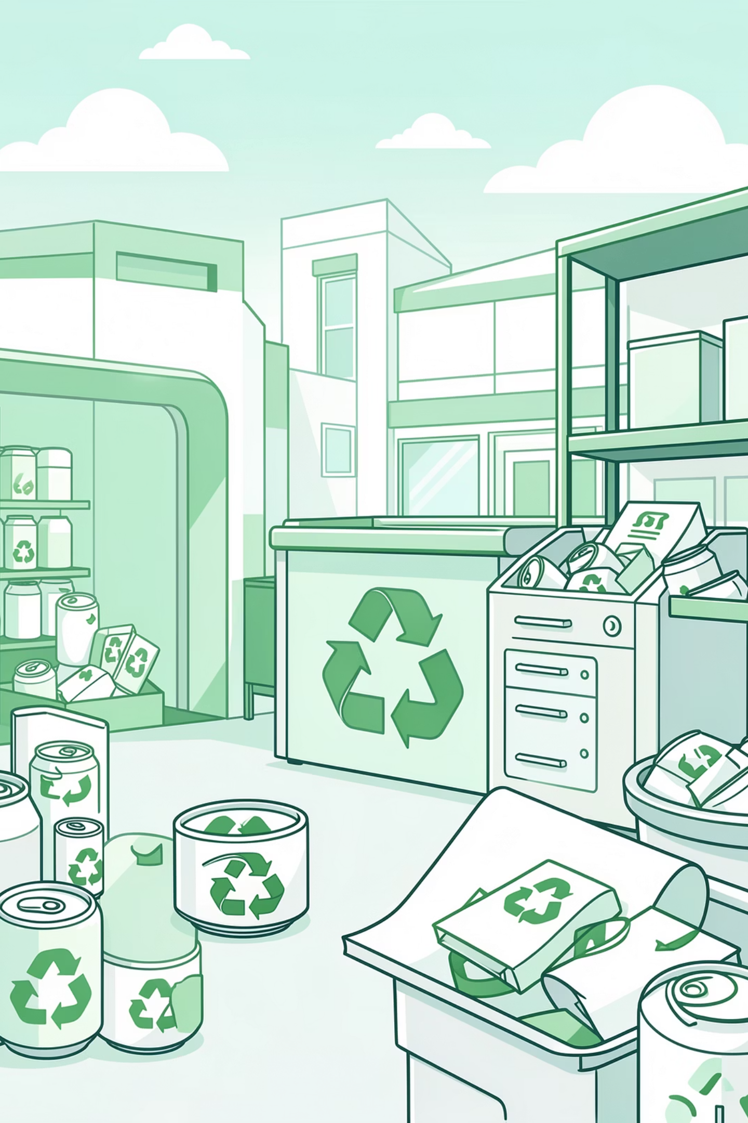
What Is Recycling — And Why Does It Matter?
Recycling means turning used materials into new products instead of throwing them away. It's one of the simplest ways to fight climate change and protect our planet.

Slide 5
The Real Impact
Recycling by the Numbers
⚡ 95% Less Energy
🌲 17 Trees Saved
Recycling aluminum cans uses 95% less energy than producing new ones from raw materials.
Recycling just 1 ton of paper saves approximately 17 trees — and thousands of gallons of water.
🌍 Less Pollution
💨 Fewer Emissions
Fewer landfills means fewer toxic chemicals leaking into our soil and water sources.
Less manufacturing from raw materials means significantly fewer CO₂ emissions.

Slide 6
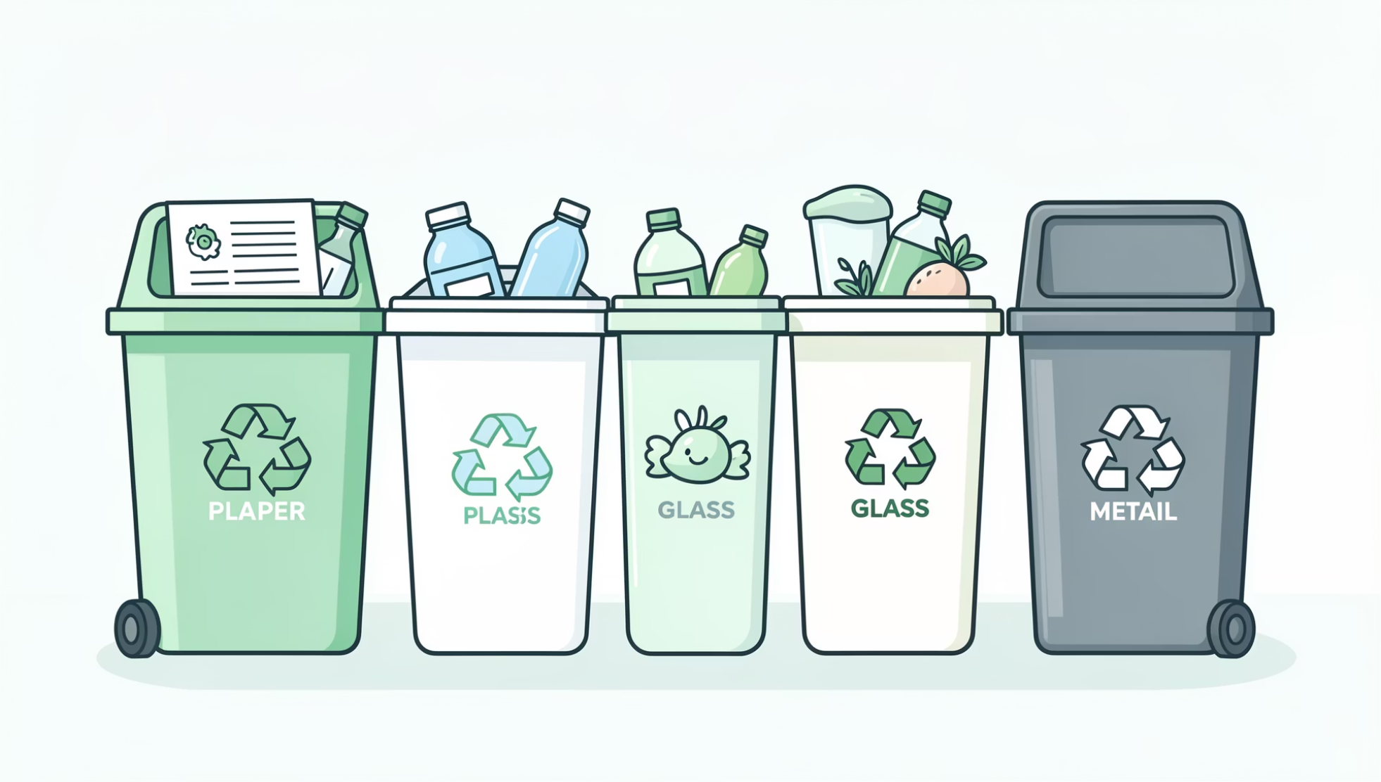

The Recycling Basics: What Goes Where?
♻️ Accepted Materials
Paper & Cardboard: Newspapers, magazines, boxes — but not wet or greasy paper
Plastic: Look for #1 (PET) and #2 (HDPE) — the most commonly recycled
Glass: Bottles and jars of any color — rinse them first!
Metal: Aluminum cans, tin cans, and clean foil
🚫 Not recyclable: Chip bags, styrofoam, plastic straws, and dirty food containers.
When in doubt, find out! Always check your local recycling guide before tossing something in the bin.

Slide 7
Common Recycling Mistakes
Good intentions aren't always enough. These well-meaning habits can actually hurt the recycling process.

Slide 8
Are You Guilty of Any of These?
Recycling Mistakes to Avoid
🤞 Wishcycling
🥜 Dirty Containers
Tossing something in the bin hoping it's recyclable. This contaminates entire batches and costs facilities time and money.
A single unwashed peanut butter jar can contaminate a whole load of recycling. Always rinse before recycling!
🛍️ Plastic Bags in Bins
🔢 Not All Plastic Is Equal
Plastic bags jam the machinery at sorting centers. Bring them back to store drop-off points instead.
Many plastic types — especially #6 styrofoam — are NOT recyclable in standard programs. Always check the number.

Slide 9
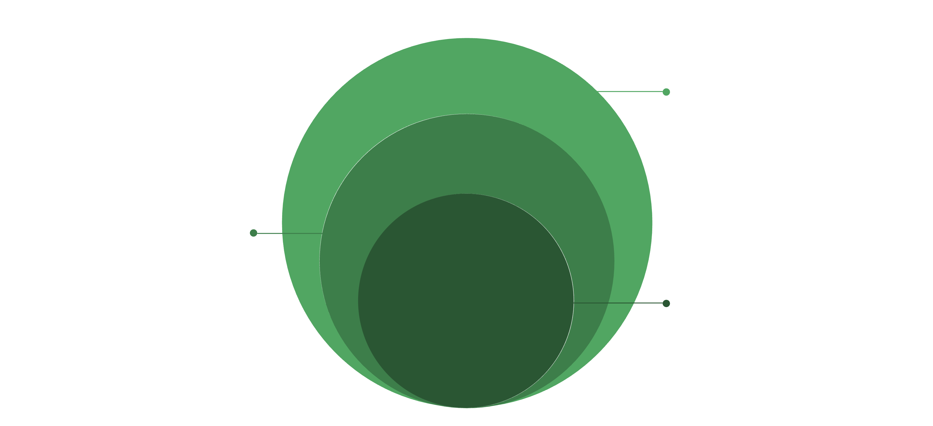
Beyond Recycling: Reduce & Reuse First!
Recycle
Recycle what remains responsibly
Reuse
Donate clothes; repurpose jars; use both paper sides
Reduce
Avoid unnecessary buys; use reusable bottles
The 3 Rs are in order for a reason. The best waste is the waste you never create. Recycling is powerful — but reducing and reusing are even better. Upcycling old t-shirts into bags or pallets into furniture? Even better still!

Slide 10
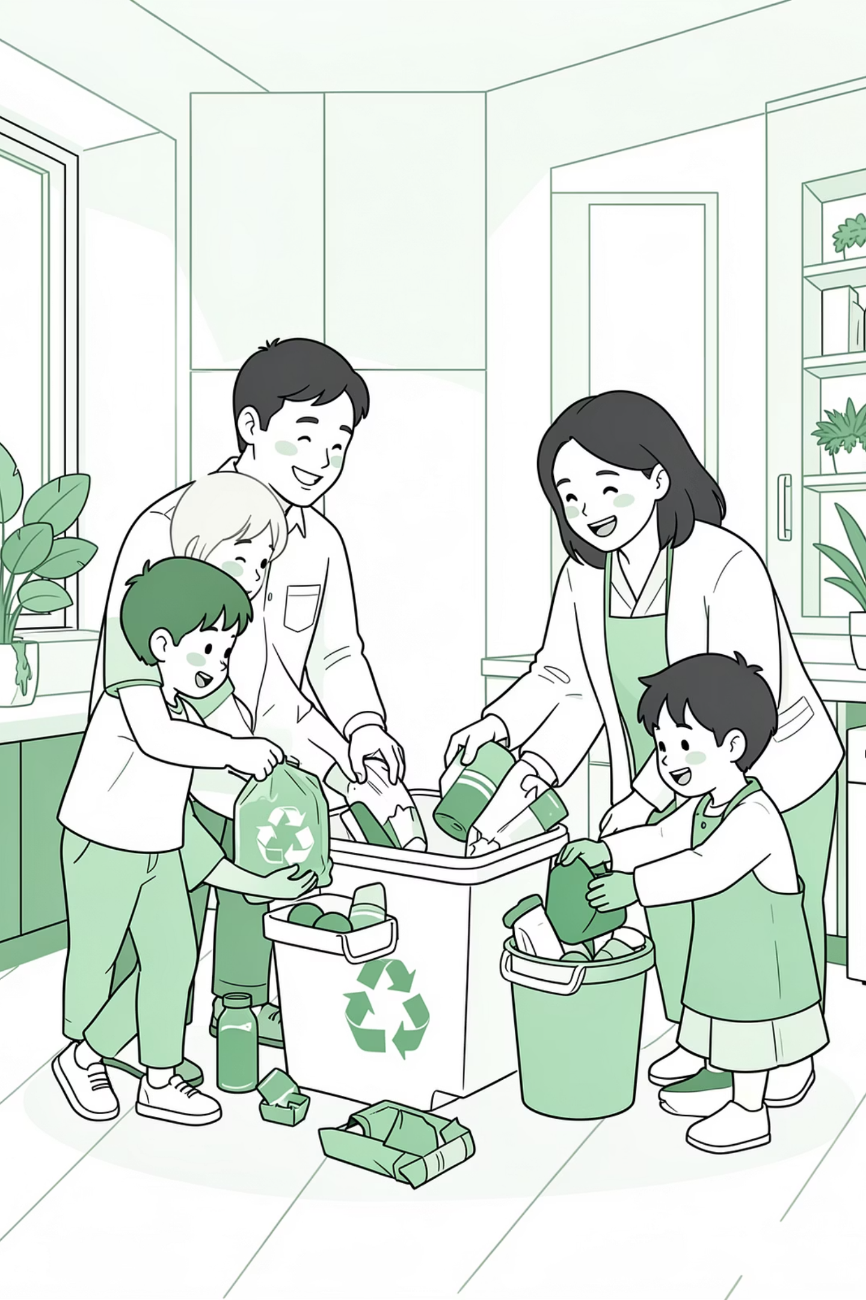
What Can YOU Do?
Small actions multiplied by millions of people create huge, real-world impact. Here's how to start today.

Slide 11

Your Call to Action
Start Making a Difference — Today
01
02
Sort Your Waste at Home
Set Up a Recycling Station
Set up simple bins for paper, plastic, glass, and general waste. Make it a daily habit.
At school, in the office, or in your community — if there isn't one, be the person who starts it.
03
04
Spread the Word
Take the One-Week Challenge
Share what you've learned with family and friends. Knowledge multiplies impact.
Try to reduce your personal waste for just one week. You'll be surprised how much you can cut.
💚 Remember: You don't have to be perfect — you just have to start. Every action counts.

Slide 12
THANK YOU FOR LISTENING!
Green Student Ambassadors from
Liceul Tehnologic Stefan Hell Santana
The European Commission's support for the production of this publication does not constitute an endorsement of the contents, which reflect the views only of the authors, and the Commission cannot be held responsible for any use which may be made of the information contained therein.

