Slide 1






GREEN SKILLS
SKILLS FOR A SUSTAINABLE FUTURE
The European Commission's support for the production of this publication does not constitute an endorsement of the contents, which reflect the views only of the authors, and the Commission cannot be held responsible for any use which may be made of the information contained therein.

Slide 2
The world is changing:
Climate change is affecting our planet and our lives.
Resources like water and energy are limited.

Slide 3

The world is changing:
Future jobs will require sustainability knowledge.
You can be a part of the solution.

Slide 4

What are green skills?
Green skills are the knowledge, abilities, and attitudes we need to live and work sustainably.

Slide 5
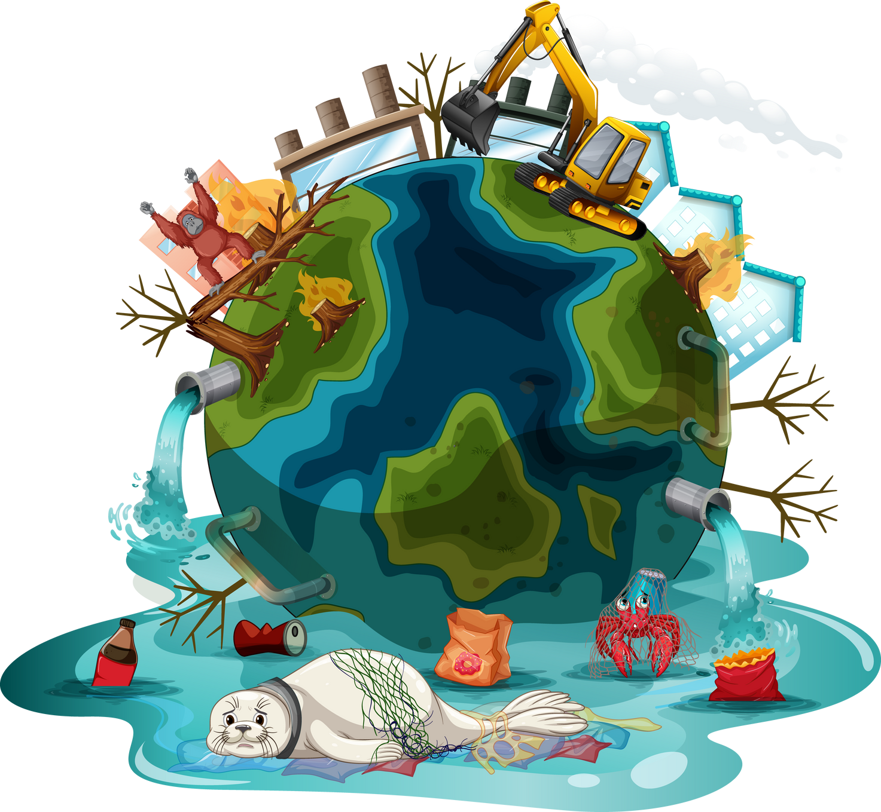
What are green skills?
They help us:
  Protect the environment
  Use natural resources wisely
  Adapt to a changing world

Slide 6

Everyone needs green skills.
  Thinking critically about environmental problems
  Being creative and innovative for solutions
  Working well with others & collaborating for the environment
  Making environmentally-responsible decisions.

Slide 7
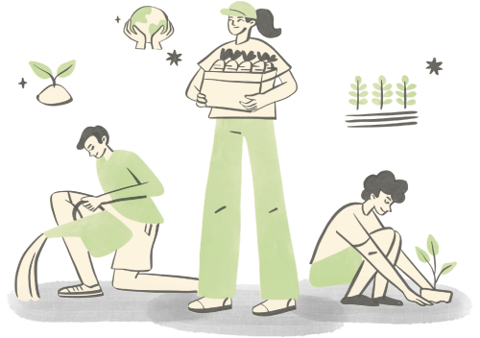
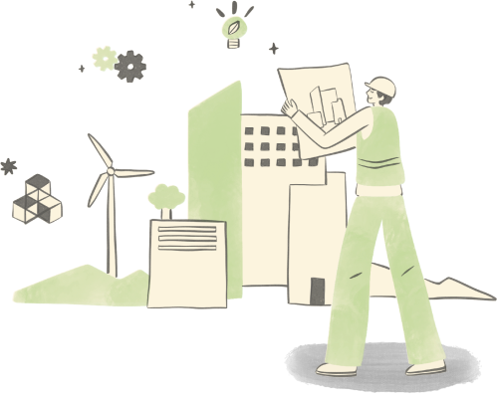
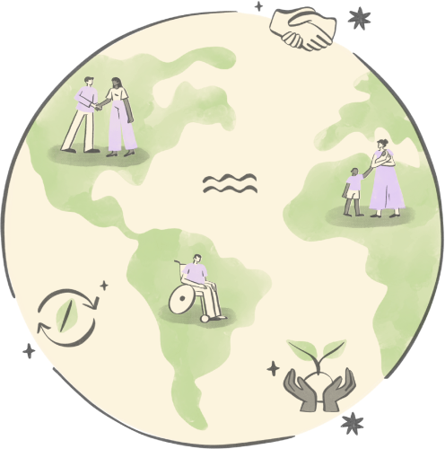
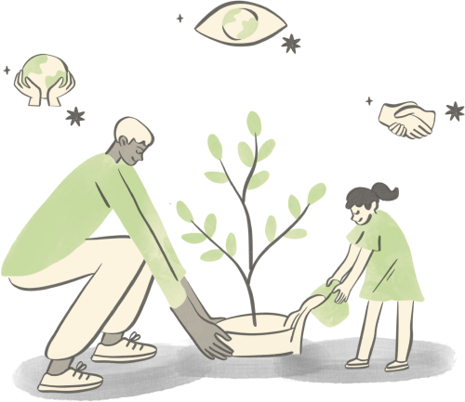
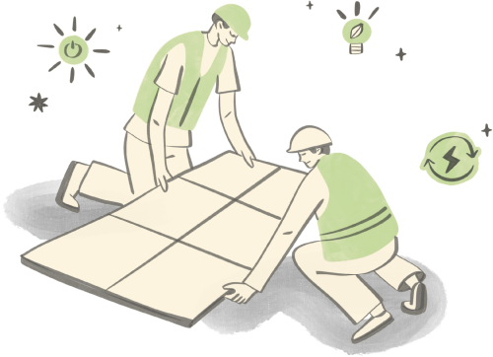
Green skills are everywhere!

Slide 8





Green skills are everywhere!
  Energy: renewable energy, energy saving
  Agriculture: sustainable farming, water management
  Construction: eco-friendly buildings
  Transportation: low-emission transport
  Education: environmental awareness

Slide 9

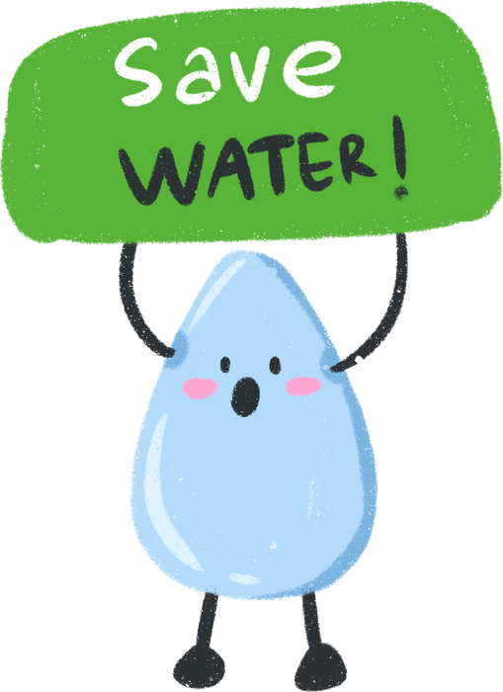






Green skills in Everyday Life
Small actions
matter!

Slide 10


You can make a difference!
Ask yourself:
  How can I be more sustainable at school?
  How can I influence my community?
  What small change can I start today?

Slide 11
Thank you.
The European Commission's support for the production of this publication does not constitute an endorsement of the contents, which reflect the views only of the authors, and the Commission cannot be held responsible for any use which may be made of the information contained therein.

