Slide 1
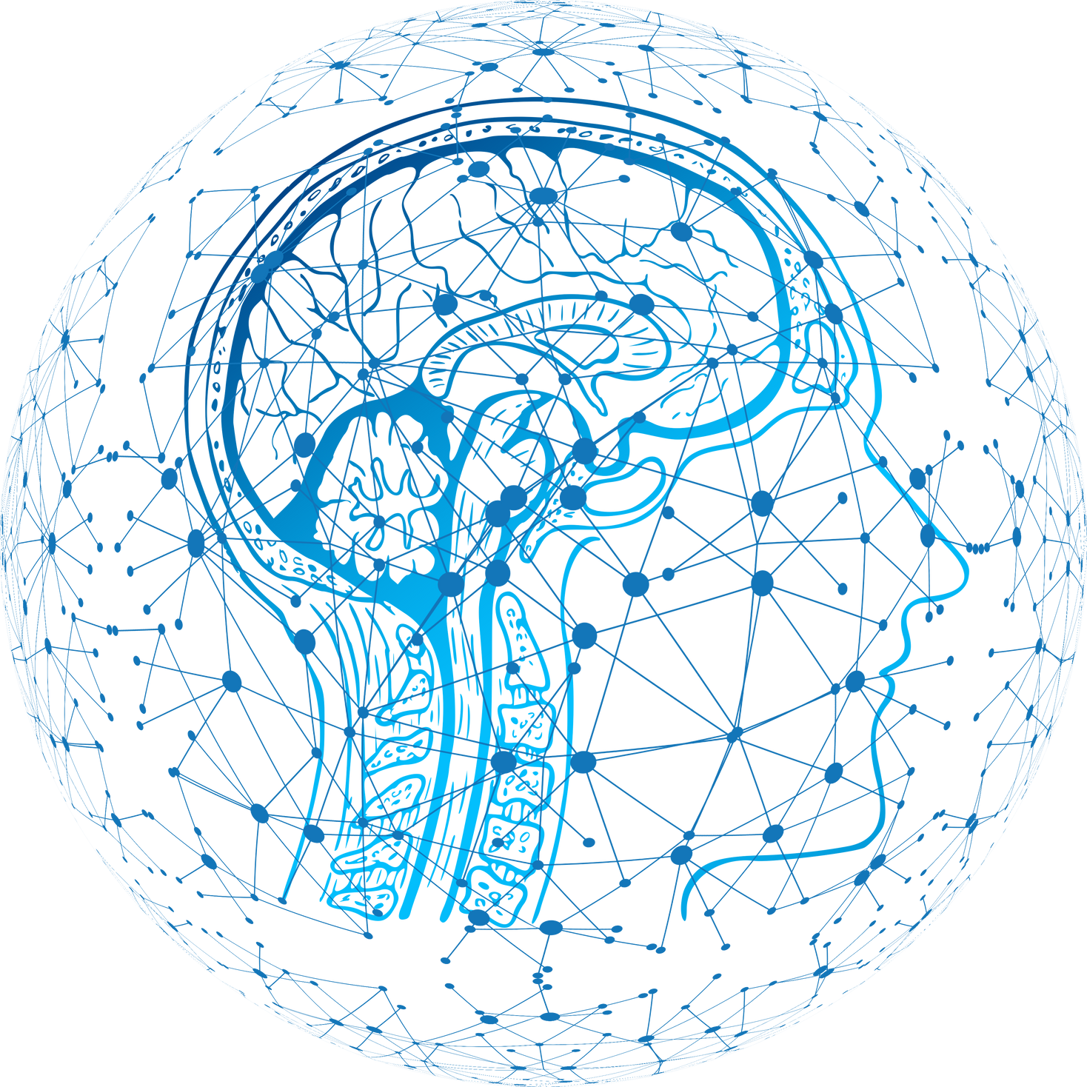

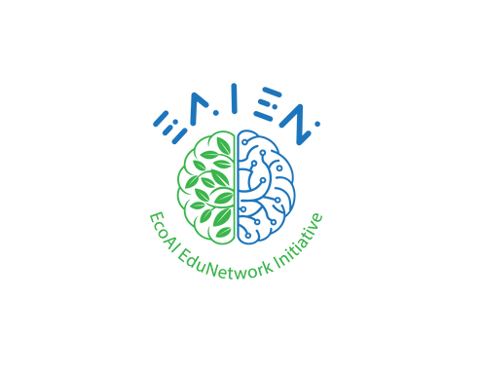



BASICS OF AI
Understanding AI in Our Daily Lives
The European Commission's support for the production of this publication does not constitute an endorsement of the contents, which reflect the views only of the authors, and the Commission cannot be held responsible for any use which may be made of the information contained therein.

Slide 2
AI is already
a part of our lives.
  AI is everywhere: phones, apps, games, school tools
  It helps us learn, decide, and communicate,
  Understanding AI helps us use it responsibly.

Slide 3

AI or NOT AI?
  A music app recommends a new song
  A microwave heats food
  Google Maps suggests a faster route
  A calculator solves 245 × 18
  A grammar app gives feedback on writing

Slide 4

Which one was confusing? Why?
What makes something “AI”?

Slide 5
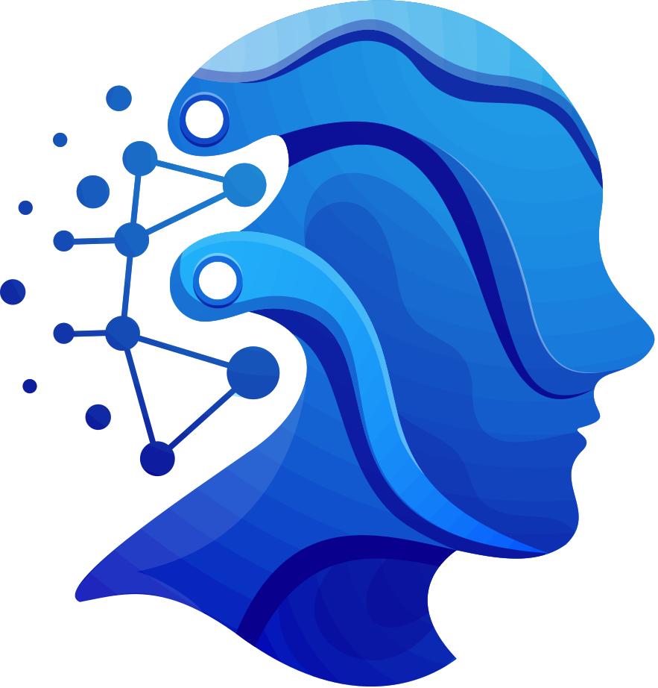
Artificial Intelligence (AI) refers to computer systems designed to perform tasks that normally require human intelligence.

Slide 6
AI ≠ Human Intelligence
Artificial Intelligence (AI)
  does not think or feel,
  does not have emotions,
  works based on data and algorithms.

Slide 7
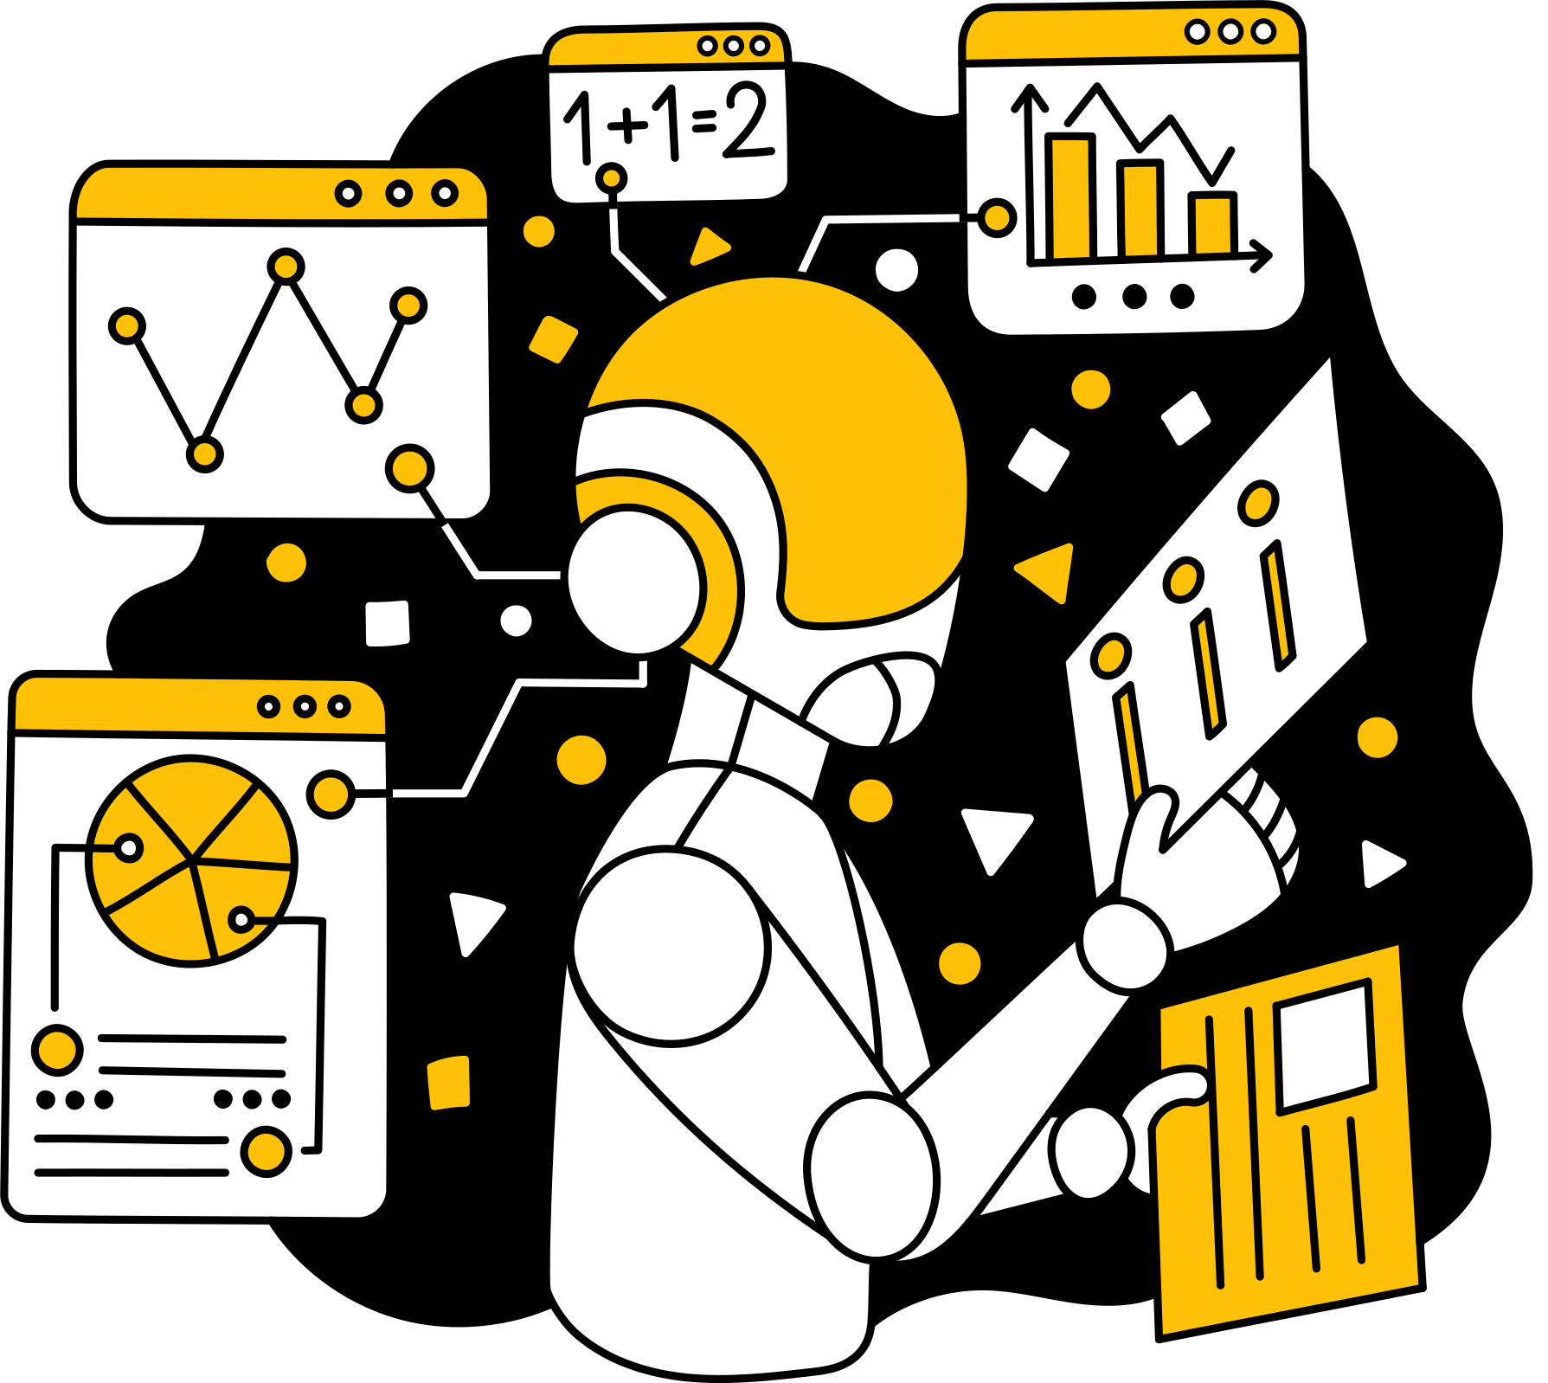
How does AI work?
From Rules to Learning
  Traditional programming → humans write rules
  AI → learns from data
  Finds patterns
  Makes predictions

Slide 8
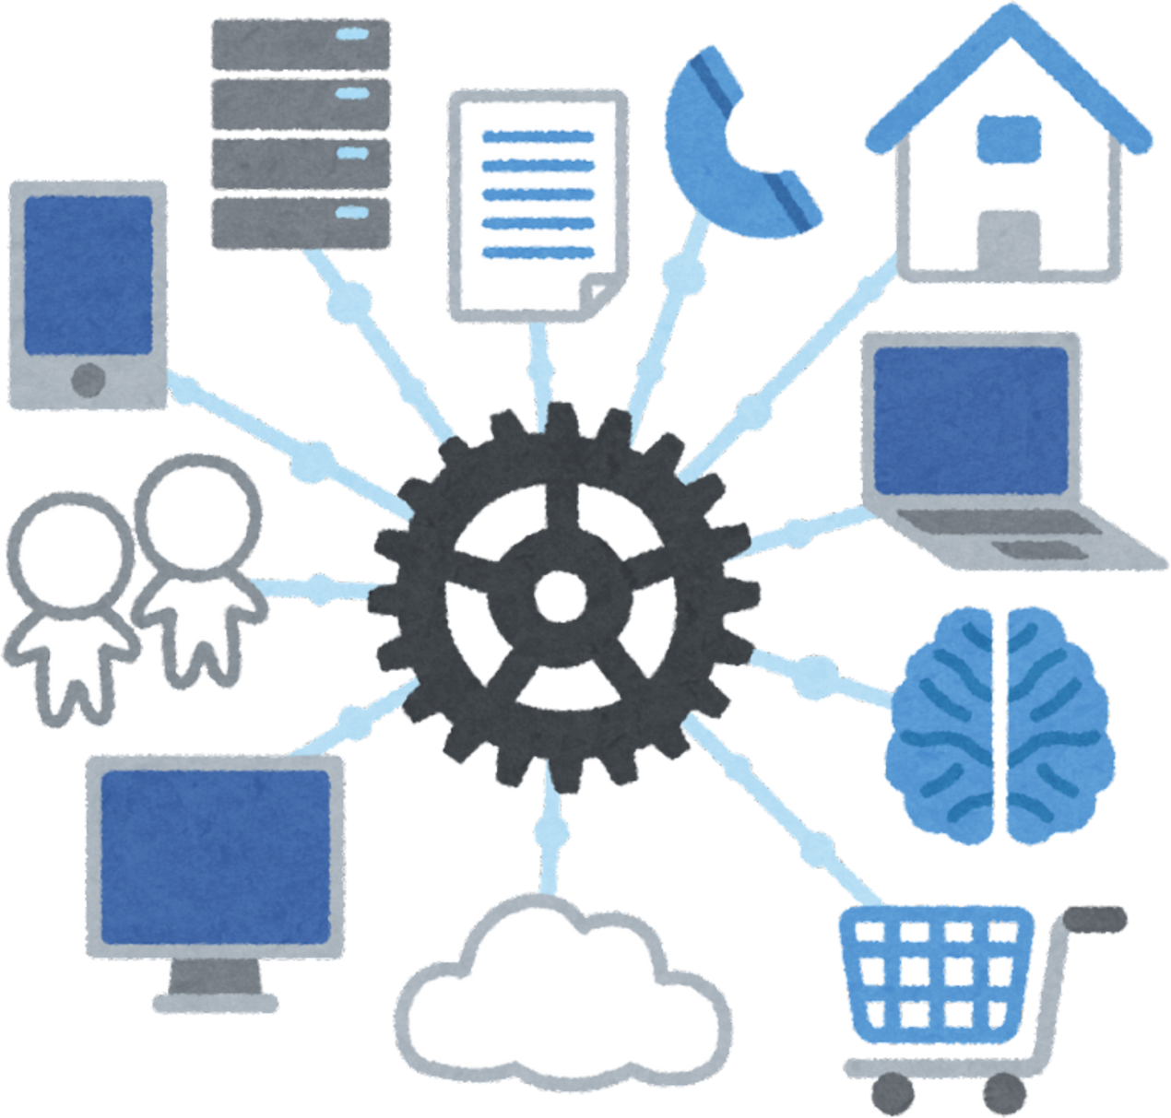
Data is the fuel of AI.

Slide 9
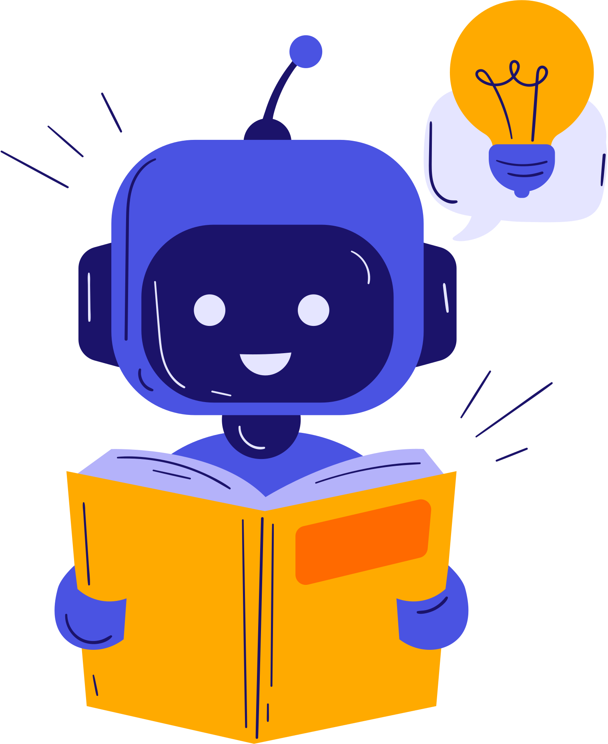
Machine Learning (ML)
Machine Learning (ML) is a type of Artificial Intelligence that allows computers to learn from data instead of being programmed step by step.
In machine learning:
  The computer is given examples and data
  It finds patterns on its own
  It improves over time as it sees more data

Slide 10
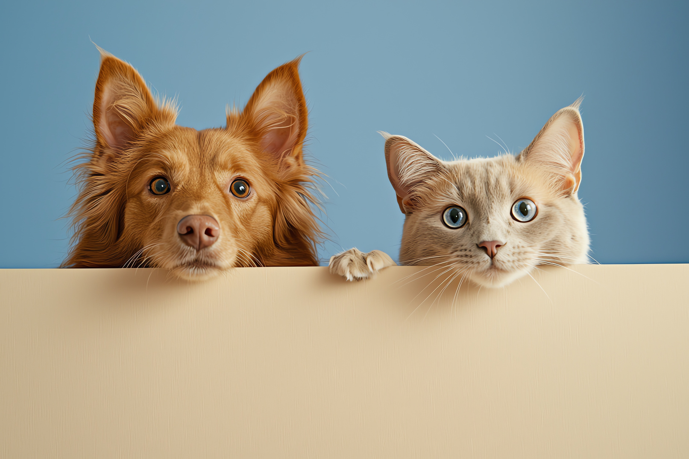
How does a computer
learn to tell if it is a cat or a dog?

Slide 11
  The computer is shown thousands of labeled photos: (This is a cat / This is a dog)
  It looks at patterns in the photos: (ear shape, size, face structure, etc.)
  The system learns patterns from the examples.
  When it sees a new photo, it makes a guess based on what it has learned.
⚠️ Important:
If the photos are not diverse enough, the computer may make mistakes.

Slide 12


Deep Learning (DL)
Deep Learning is a special type of machine learning that uses systems inspired by the human brain, called neural networks.
Instead of learning from data in a simple way, deep learning:
  Uses multiple layers of learning
  Processes information step by step
  Learns complex patterns in data
“Deep” means many layers, not “smart.”

Slide 13

Where do we see DL?
Deep learning powers:
  Voice assistants (speech recognition)
  Face recognition
  Image and video analysis
  Language models (chatbots, translation tools)
📱 Most “smart” AI tools today use deep learning.

Slide 14

Why do you think deep learning needs more data than machine learning?

Slide 15
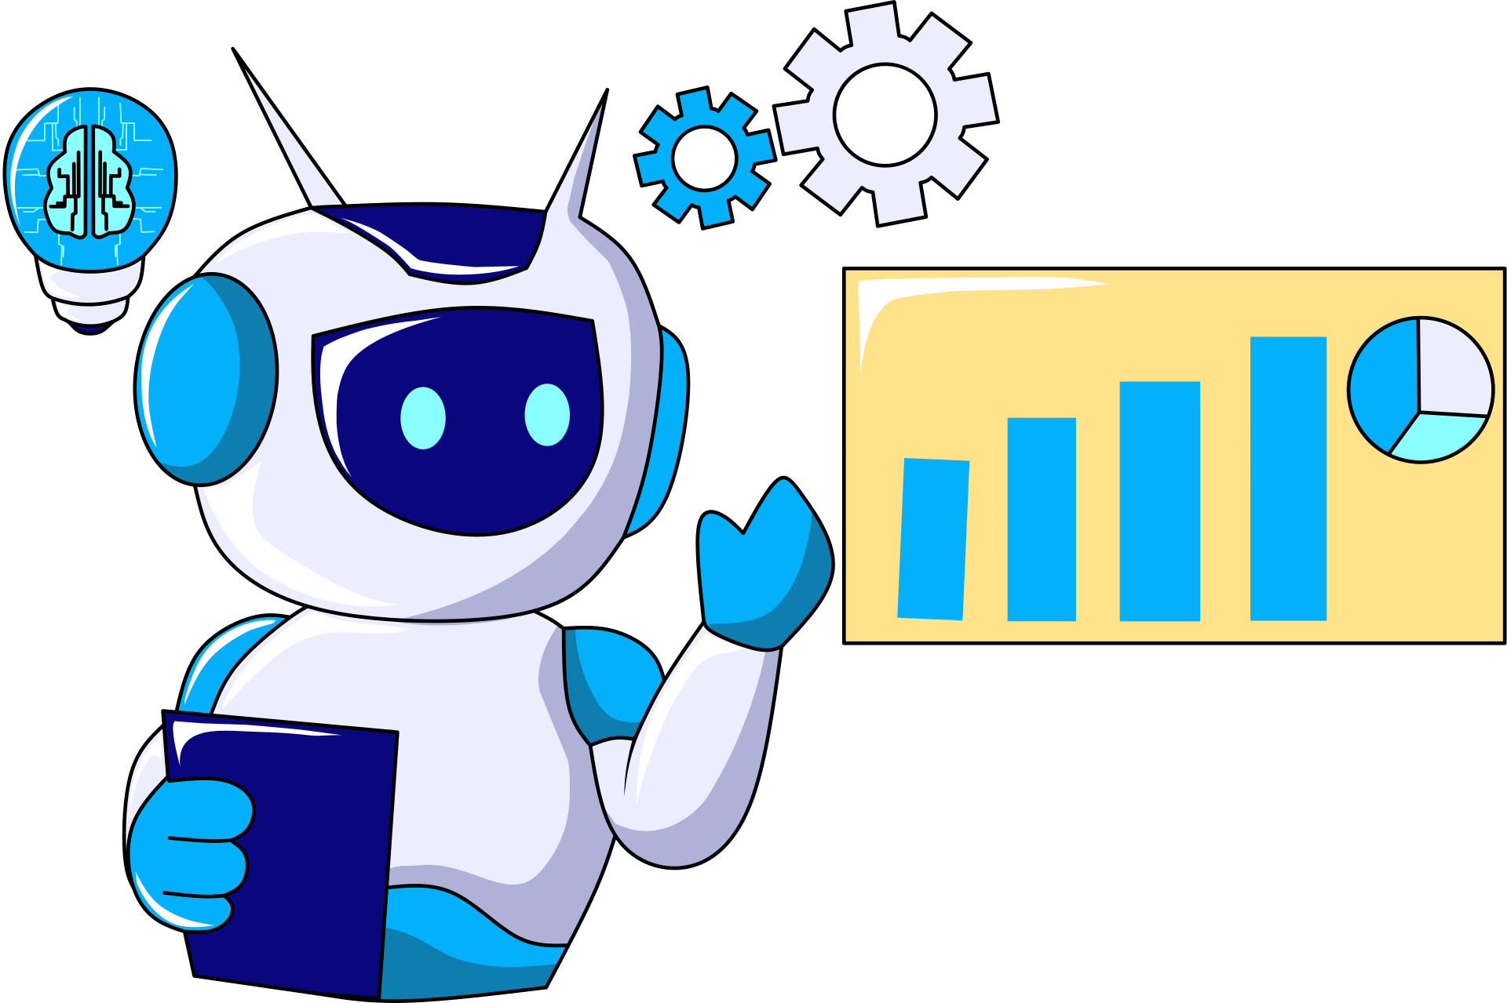
Deep learning needs more data because it does not understand meaning.
  It does not know what a “cat” or a “dog” is
  It only recognizes patterns, not ideas or concepts
  The system learns through many layers, and each layer needs examples

Slide 16
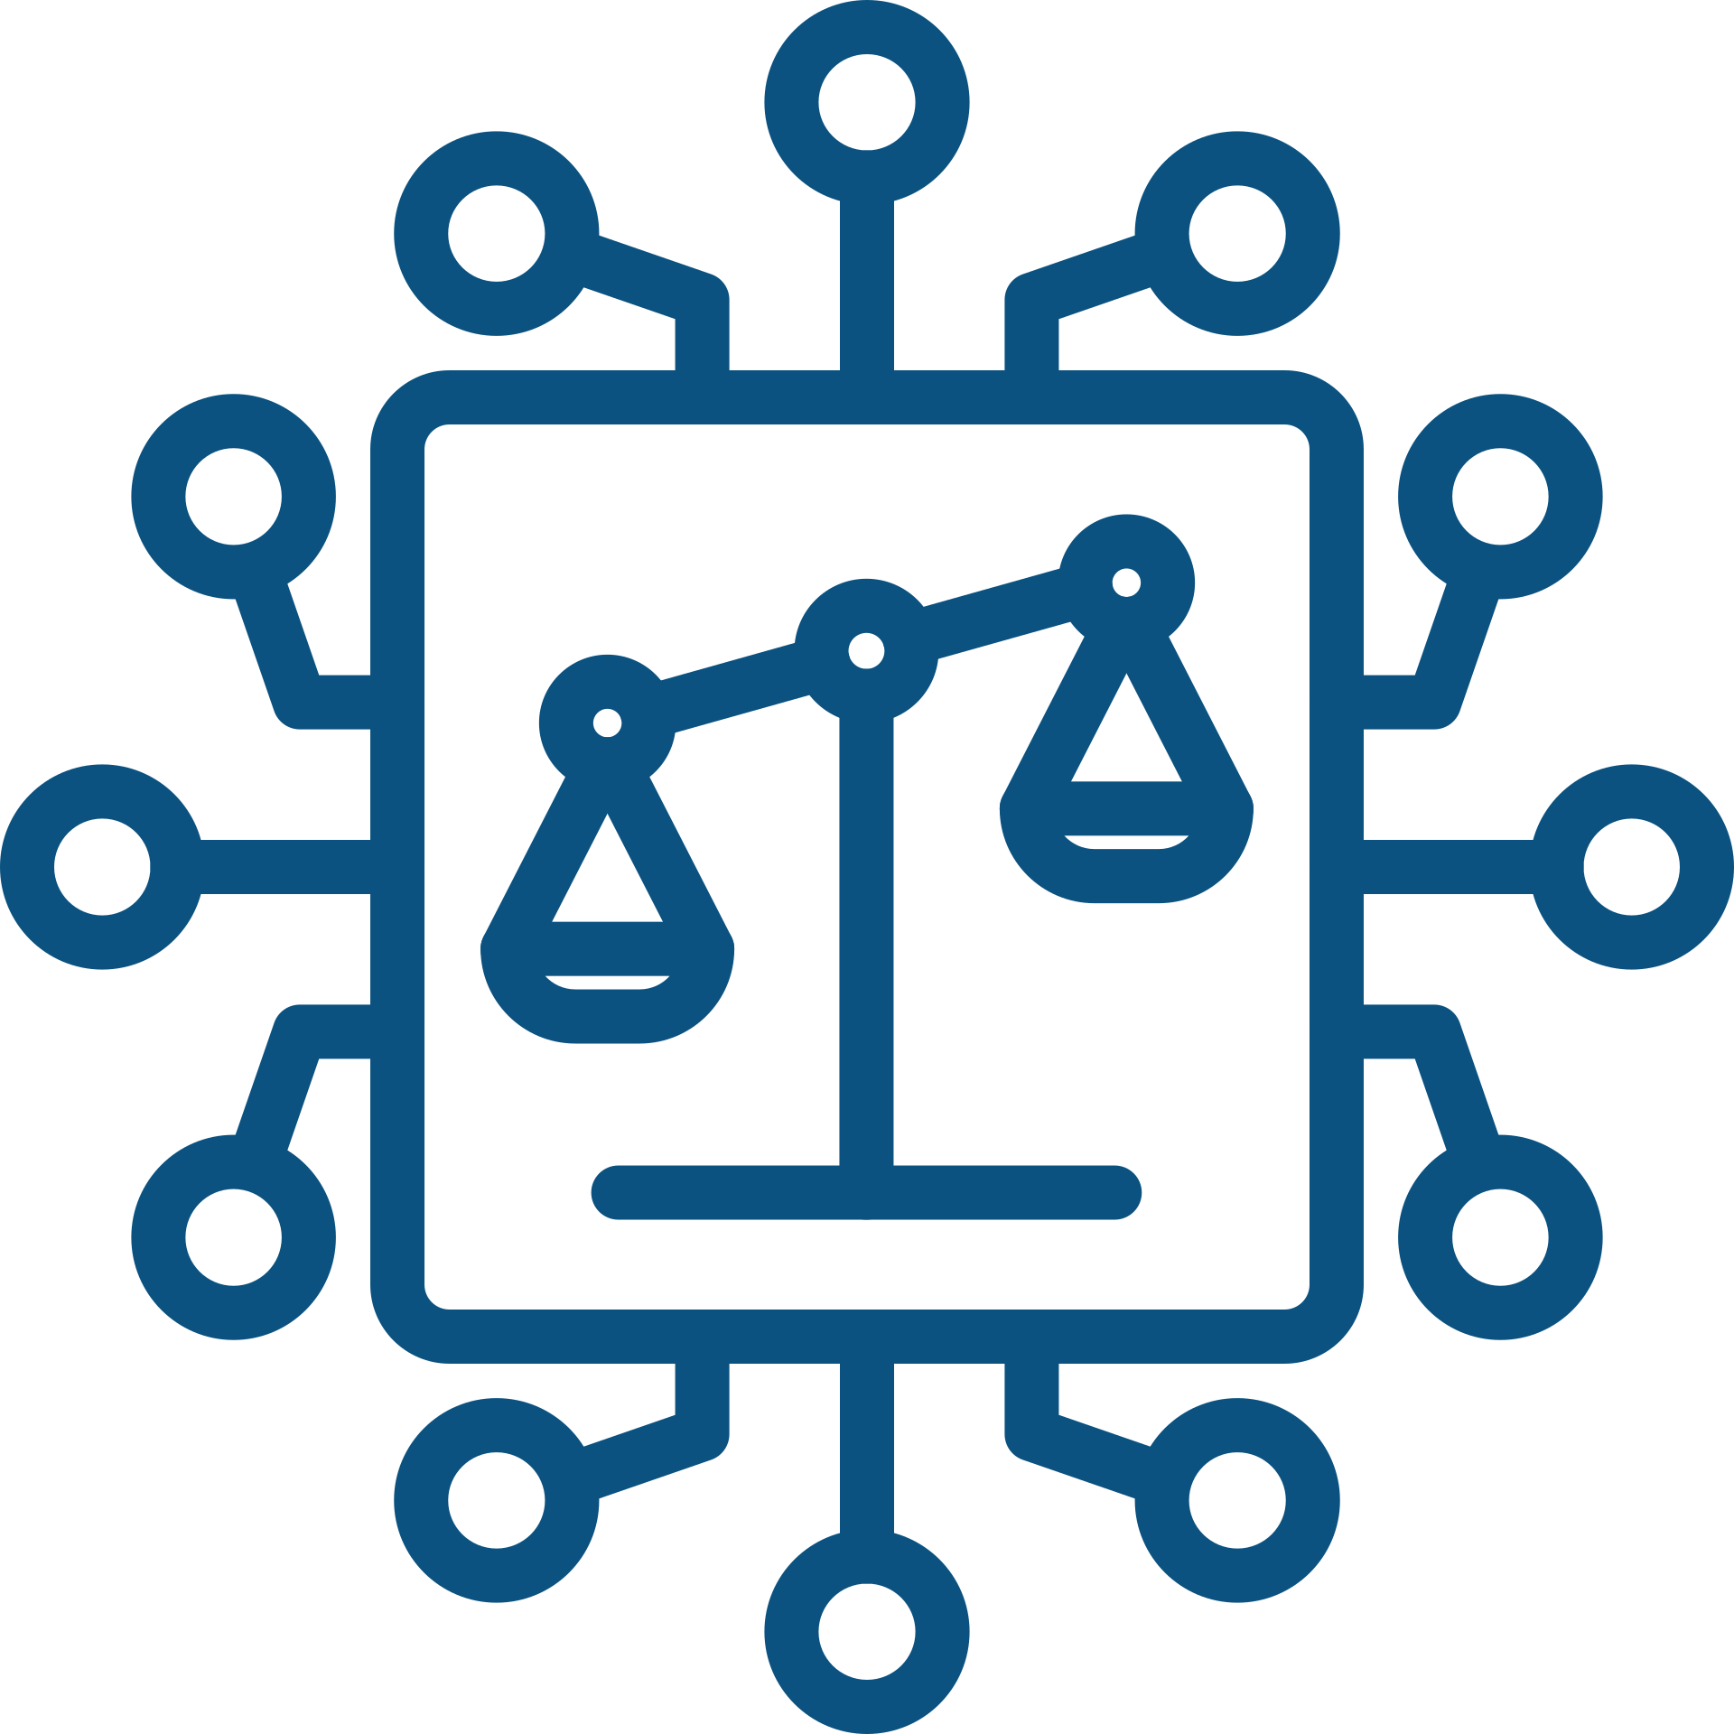
If the data is:
  Limited, the model cannot learn well
  Biased, the model may learn the wrong patterns
This means errors can happen.That’s why human supervision is always essential.

Slide 17

AI is your co-pilot.
  Learning support
  Creativity (writing, visuals, ideas)
  Research and presentations

Slide 18

AI is a TOOL.
  AI can help.
  Humans decide.
  Responsibility matters.

Slide 19
Thank you.
The European Commission's support for the production of this publication does not constitute an endorsement of the contents, which reflect the views only of the authors, and the Commission cannot be held responsible for any use which may be made of the information contained therein.

