Slide 1


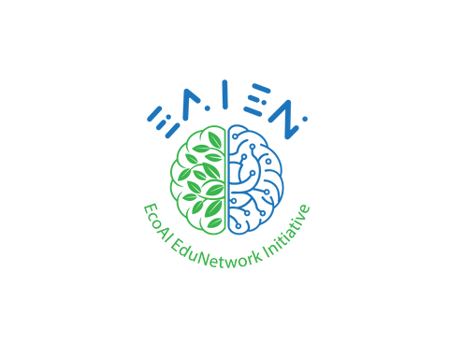



AI TOOLKIT
Tools for EAIEN Green Skills Student Ambassadors
The European Commission's support for the production of this publication does not constitute an endorsement of the contents, which reflect the views only of the authors, and the Commission cannot be held responsible for any use which may be made of the information contained therein.

Slide 2
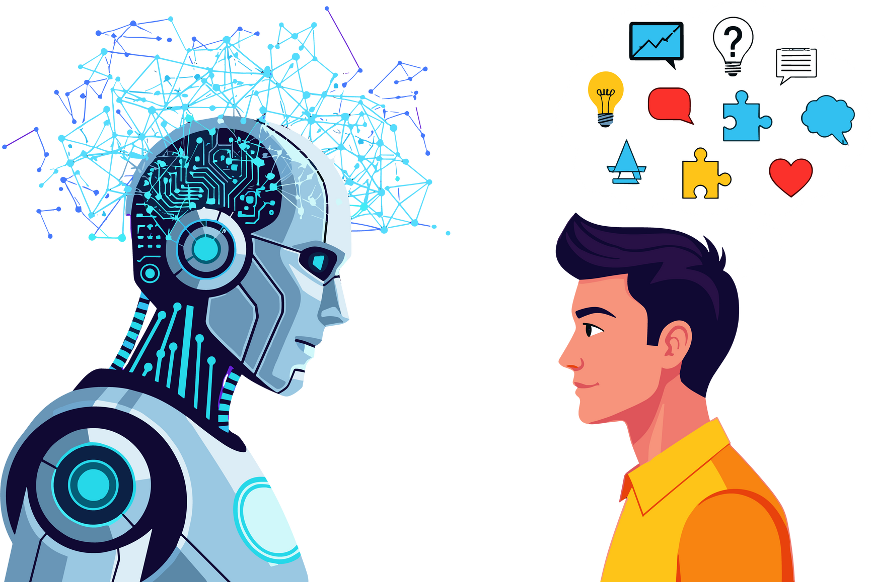
WHAT CAN YOU CREATE WITH AI?

Slide 3

With AI, you can create:
  Posters & infographics
  Presentations
  Videos
  Stories & texts
  Quizzes and games
  Songs or podcasts

Slide 4


LLMs : ChatGPT, Gemini
What can you do using large languges models like ChatGPT or Gemini?
  Get ideas for projects
  Write short texts or stories
  Create discussion questions
  Summarize topics

Slide 5


CanvaAI, Adobe Firefly
What you can do:
  Design posters for campaigns
  Create visuals for presentations
  Turn ideas into images

Slide 6

Gamma, Canva AI
What you can do:
  Create structured slide decks
  Turn text into visuals
  Present ideas clearly

Slide 7



Synthesia, Heygen, ElevenLabs
What you can do:
  Create short explainer videos
  Record audio stories
  Prepare campaign videos

Slide 8

How can you use these tools to promote
sustainability in your schools or community?

Slide 9

Examples
A green awareness poster
A short video about recycling
A presentation on climate change
A quiz for your classmates
Your ideas + AI tools = powerful projects

Slide 10

Let’s think together!
  Which tool sounds most interesting?
  What would you like to create with AI?
  How can AI help you learn better?

Slide 11
Thank you.
The European Commission's support for the production of this publication does not constitute an endorsement of the contents, which reflect the views only of the authors, and the Commission cannot be held responsible for any use which may be made of the information contained therein.

